Slide 1
GPS Standard Positioning Service Navigation Solution Software
Patrick Lasagna – Sonal Ranjit

Slide 2
Project Objective
To get an epoch by epoch least squares position solution of a receiver using its observation and navigation RINEX files.

Slide 3
What is a RINEX file?
Receiver Independent Exchange Format
Contains raw Satellite observation and navigation data that can be robustly post processed in order to determine an accurate receiver position

Slide 4
Workflow Diagram
RINEX
Navigation
File
Reader Class
RINEX Observation
File
Navigation Dictionary
Observation Dictionary
SatPos
Least Squares Filter
Run for all Observation Epochs
Receiver ECEF Coordinates and Receiver Clock Error

Slide 5
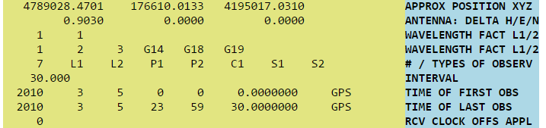
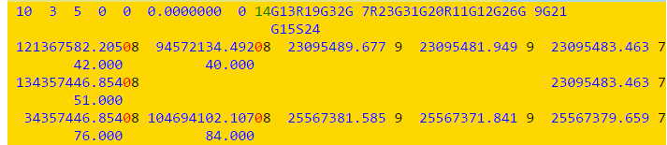
RINEX Reader
RINEX files are precisely spaced ascii files that are split into two main parts.
Header
RINEX Body

Slide 6
Python Dictionary Data Structure
A series of key value pairs, where an alpha-numeric key corresponds to a data value.
“P001”
“Point Network”
“P001”
“Point List”
“ID”
“Position”
“X Position”
“Y Position”
“Z Position”
17.354
17.354
17.354
[“P001”,….. “Pn”]

Slide 7
RINEX Observation Reader
RINEX Observations are stored on an epoch by epoch basis. Each epoch has several GPS satellites with several pseudorange measurements.
{'07:1:1:0:0:0.0000000': {'EFLAG': '0',
'G06': {'C1': 20857582.237,
'L1': -19771364.963,
'L2': -15406250.872,
'P1': 20857582.016,
'P2': 20857580.516,
'S1': 44.8,
'S2': 40.0},

Slide 8
RINEX Navigation Reader
RINEX Navigation files are ordered by satellite. Each contain 29 navigation parameters and the epoch they are valid for.
{'G01': {'10:1:1:16:0:0.0': {'Cic': 5.587935447693e-09,
'Cis': 7.636845111847e-08,
'Crc': 183.21875,
'Cuc': -8.651986718178e-06,
...
'Io': 0.9635689853388,
'Mo': 0.0841761497488,
'OMEGA': -0.1005044703918,
'OMEGA_DOT': -7.951402636407e-09,
'Omega': 0.9428572252394,
'SqrtA': 5153.668302536,
'Trans_time': 487788.0},

Slide 9
Satpos Function
Given an input epoch (and associated navigation parameters), satellite, and pseudorange, determine the position of a satellite.
Determine the closest valid epoch that is less than the input epoch and is no more than two hours away.
Compute the satellite’s position using the navigation data at the correct epoch
If no valid epoch found, ignore this satellite

Slide 10
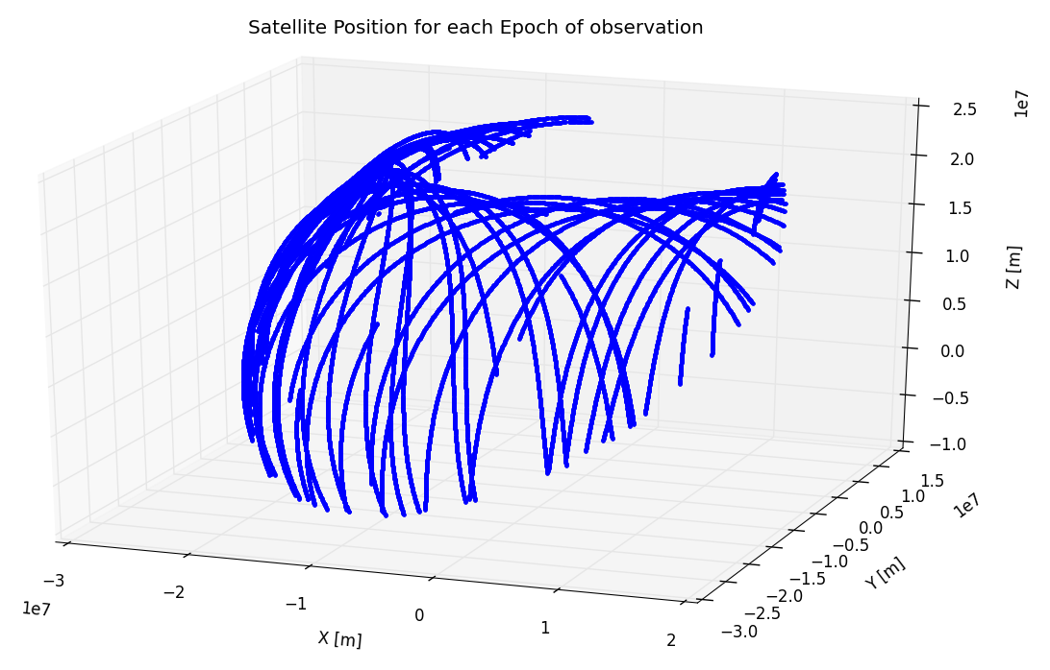

Slide 11


Least Squares Filter
Pseudorange Equation:
Mathematical Model:
Non-Linear!
Iterative Solution Required Via Taylor’s Theorem!

Slide 12
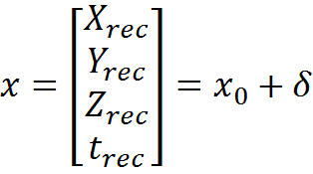
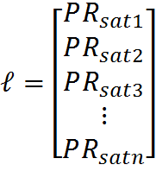

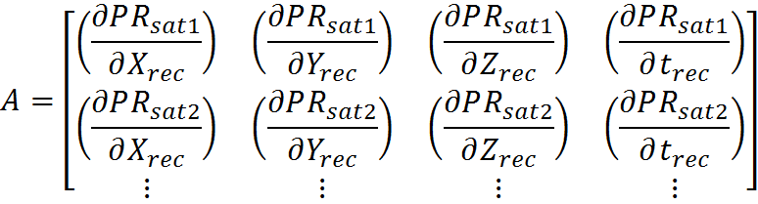

Least Squares Solutions

Slide 13
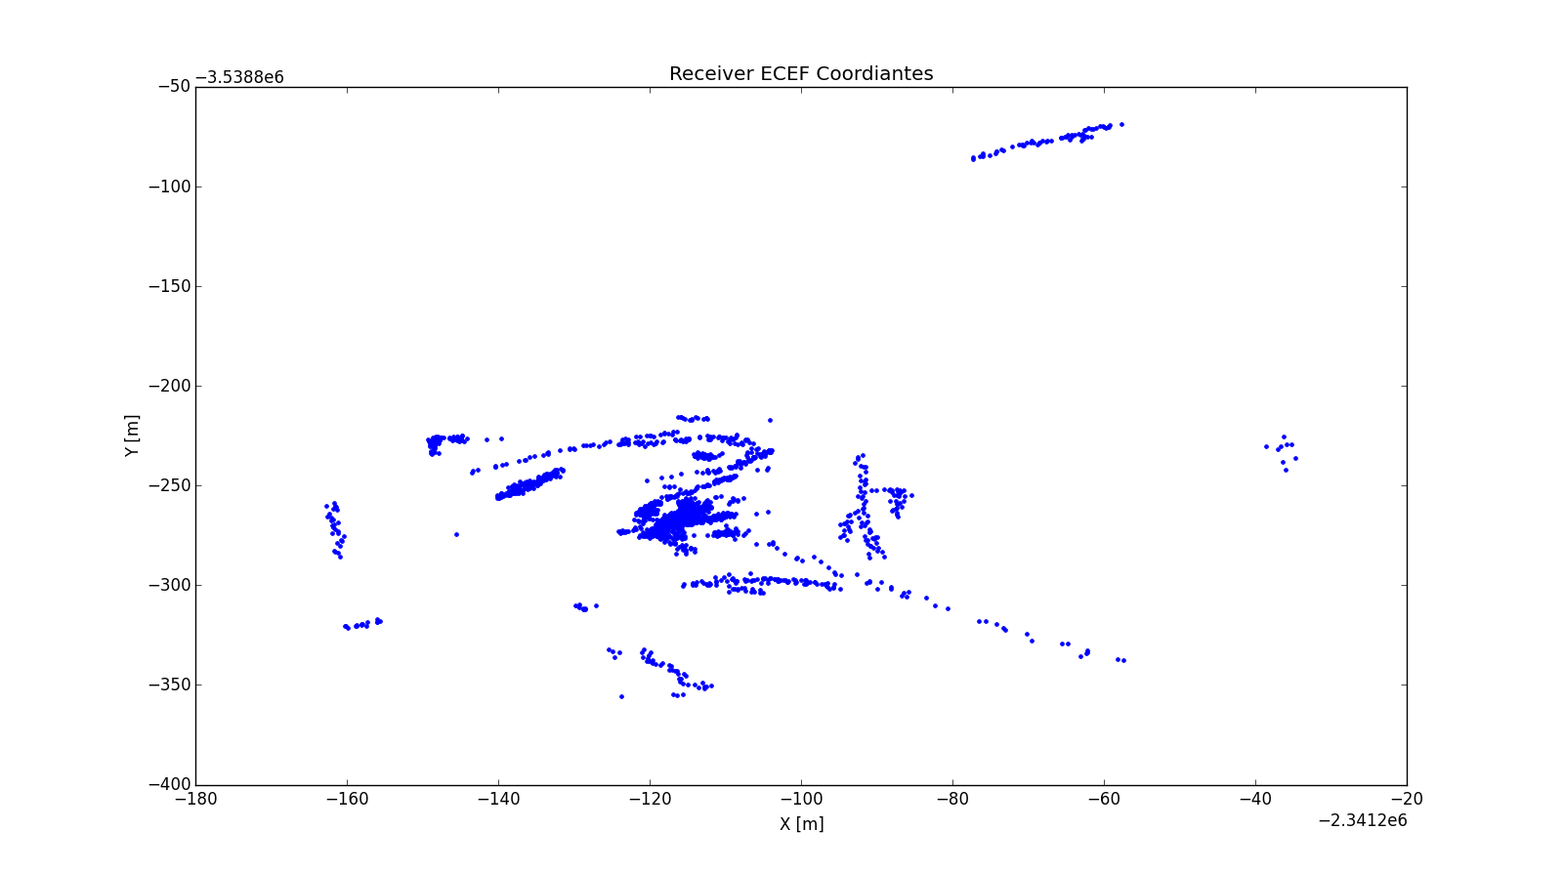
Results

Slide 14
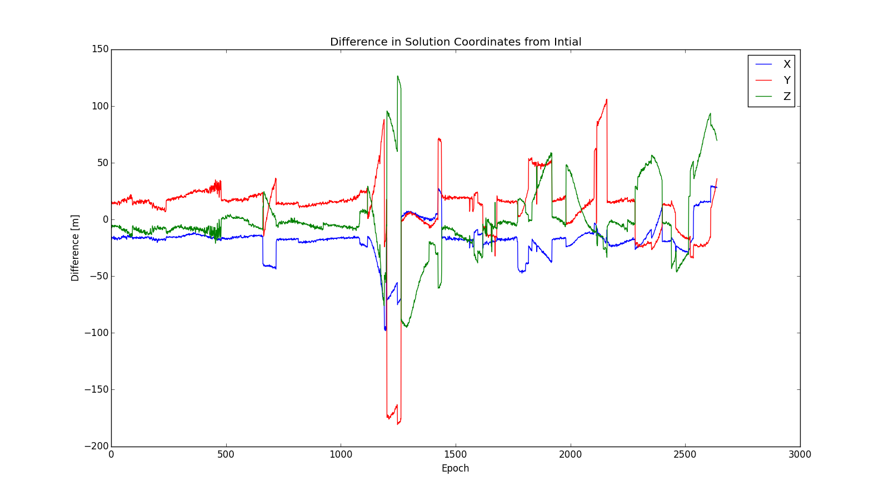
Difference in Solution from Initial

Slide 15
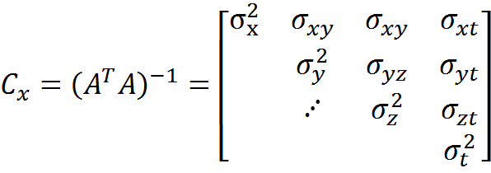
DOP Generation
A no nonsense estimator of how good a GPS solution is. Based entirely on satellite geometry and derived from the covariance matrix of the unknowns.

Slide 16

Geometric DOP
Measure of how good the solution as a whole is

Slide 17
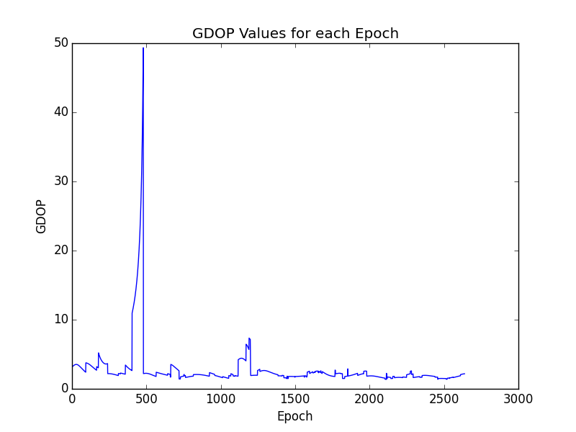
GDOP

Slide 18

Position DOP
Measure of how good the position solution is

Slide 19

PDOP

Slide 20
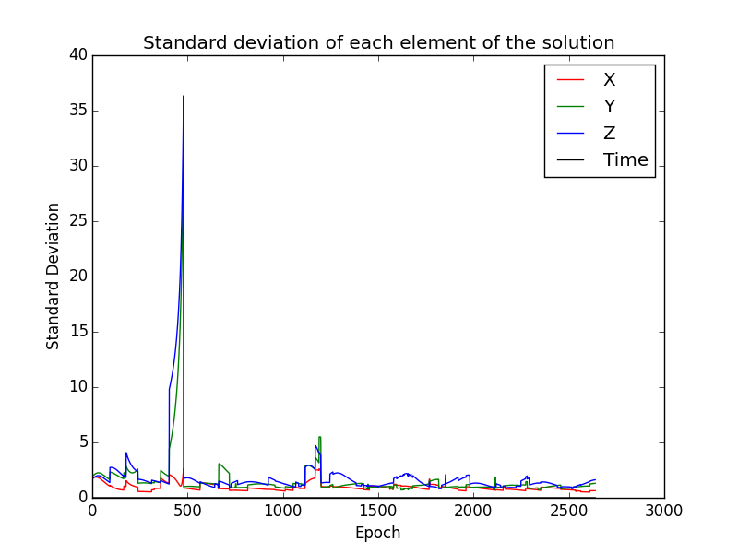
Standard Deviation per Solution

Slide 21
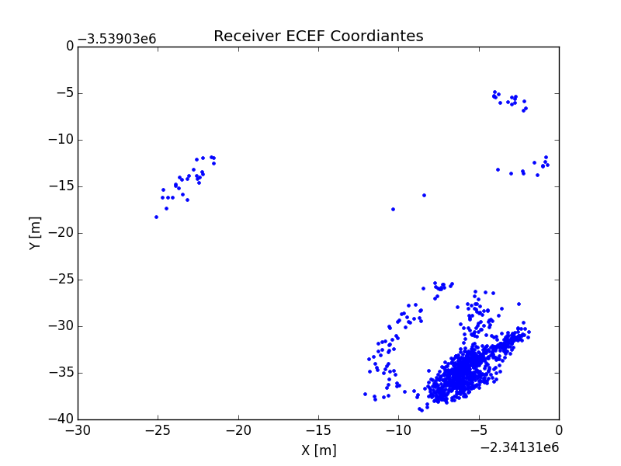
Removing Gross Outliers

Slide 22
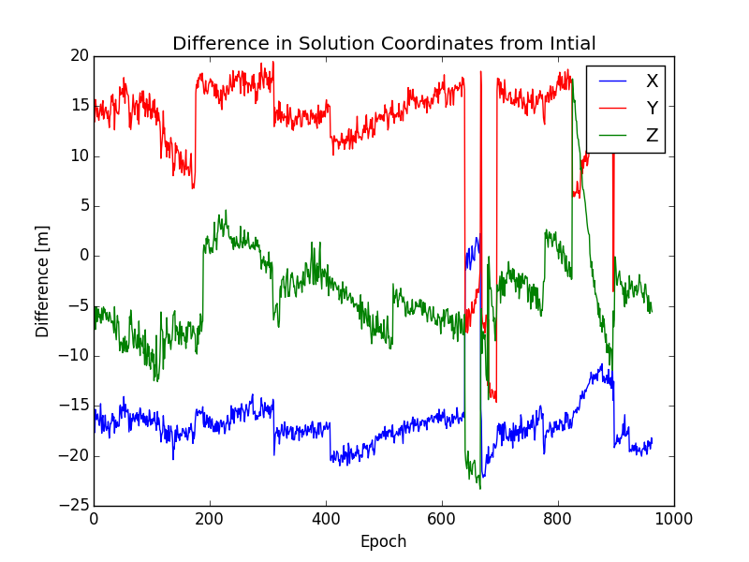
Difference in Solution from Initial

